Slide 1

Refined Real Estate
Home Buying 101
Changing the Real Estate Experience

Slide 2
Our Philosophy: Advancing the real estate experience through client education, collaboration and communication to instill client confidence.
Refined Real Estate is a boutique real estate brokerage that delivers an individually tailored experience that best suits each of our clients. We work hand in hand with our clients to understand their needs, provide excellent communication and deliver a smooth transaction. This level of collaboration instills the confidence our clients need in the largest transactions of their life.
Refined Real Estate strives to educate our clients on the transaction process and how they can best make informed decisions. We don’t lead our clients into decisions that make our jobs easier just to get a deal closed. We take the time to lay out all the options and provide our clients with the tools to drive their process. Every home and every person is different and we do not fit our clients into a cookie cutter approach like large real estate companies offer.
​
Being a boutique brokerage, Refined Real Estate focuses on the quality of our transactions and not the quantity. Our goals are not tied to the number of properties sold but rather to our client satisfaction.
​
Lastly, we are passionate about real estate. We love the excitement of open houses, learning the new idiosyncrasies of the industry and meeting new people. We hope for the opportunity to work with you – never hesitate to give us a call and ask us a question.

Slide 3


About us
Brittany Cavallo
Co- Founder and Broker
Brittany is a real estate Broker with over 10 years of experience. Prior to co founding Refined Real Estate, Brittany worked in construction and real estate in many different aspects. Her well rounded experience allows her to handle deals from $11,000 mobile homes to your multi-million dollar dream home and large commercial investments.
​Brittany co-founded Refined Real Estate, a company that is dedicated to improving and elevating your experience with real estate and puts client satisfaction above all else. Brittany’s goal is to develop a sense of trust with her home buyers and sellers to help best represent them.
Mark Terry
Co- Founder and Agent/Architect
Mark is a registered and practicing Architect that is passionate about building, renovating and unlocking the potential of real estate. His 15 years of architectural practice bring a unique vision to real estate sales and investments. Mark’s experience allows him to assess properties and work with his clients to find their best use. Mark enjoys applying his practical knowledge in the pursuit of real estate and helping others succeed.
​
Mark has worked across the industry from designing kitchen renovations to managing design and construction of $60M projects for the biggest tech companies in the Boston area. For the past few years Mark has lived in Braintree and Weymouth, settling into the South Shore lifestyle.
Why work with Refined Real Estate?
Unique construction and architectural expertise
Dedicated team with over 25 years of combined experience
Commitment from both Owners to get the most out of your home
“Outside the box” thinking and tailored solutions to your property
Outstanding marketing process

Slide 4
The Homebuying Process
In this presentation we will answer the question, “What steps are involved in purchasing a home?” In addition, it will explain the services that we provide as your partner in the process. We pride ourselves on our professional approach to our work and exceptional services to our clients.
What to expect:
Our goals are to understand your home buying needs, and to see if mutually we would make good partners in your home search.
Topics we will cover include:
Information about brokerage services
Finding a home
How to get pre-approved for a mortgage
Homeowners Insurance
Home Warranties
Home Inspections
Approach to Finding your next home

Slide 5
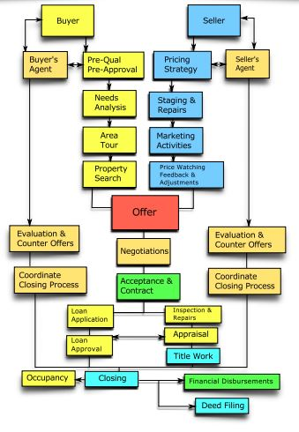
The Circle of Real Estate
The Circle of Real Estate

Slide 6
Overview
This page is to provide an overview of the home buying process from start to finish
Find a Real Estate Consultant
Step 1: Find a consultant that you find trustworthy and easy to work with. Professionalism and Preparedness should greatly influence your decision. Once you decide who you will partner with, we recommend signing a Buyer Agreement.
It guarantees that your interests are protected through the entire buying process.
Step 2A: meet with a lender or mortgage broker you feel comfortable with to determine how much house you can afford. Obtain pre-approval for the loan amount you need. This will save time in the home search, and improve your negotiating position with home sellers. We cannot put an offer in on a home without a pre-approval.
Begin Loan Approval Process
Step 2B: Put together your wants and needs list for your next home. We will then plan the homes that are currently on the market to show based on your criteria and work together to see which homes fit and fine tune your needs. Our goal is to find your next home within 5-7 showings. Market depending.
Look for your Next Home
Step 3: When you find the next home, we will put a competitive offer in. We will represent you during contract negotiations and advocate for you and ensure the terms are in your best interest. The process may include a counter offer from the seller. We’ll work with the seller to accommodate their needs and ensure a win-win deal
Make an Offer
Step 4:final details are handled and inspections are performed to ensure the property is what you want. Contract details such as repairs are further negotiated. During this time you’ll need to arrange insurance for your new home. Your title insurance company will provide a Commitment for Title Insurance for you to review.
Inspections, Repairs, and Insurance

Slide 7
Overview
This page is to provide an overview of the home buying process from start to finish
Closing on your Home
Step 5: You will need to bring a certified check or wire funds and picture ID to the closing which is either held at registry or attorneys office. Possession of your home will occur when your lender releases funds to the seller. This can often happen the same day you sign the closing documents. Once this is complete, the next step you will take will be over the threshold of your new home!

Slide 8
Information on Brokerage Services
Brokerage Relationships:
In Massachusetts we as brokers and salespeople are required to disclose the type of working relationship we have with parties in the transaction. There are several types of relationships that are available to you. Depending on what we are accomplishing working together, relationships might change from time to time so it is a good idea to know and understand the different types.
SELLER'S AGENT: A seller can engage the services of a real estate licensee to act as the seller’s agent in the sale of the seller’s property. This means that the real estate agent represents the seller, who is a client. The agent owes the seller client undivided loyalty, reasonable care, disclosure, obedience to lawful instruction, confidentiality and accounting. The agent must put the seller's interests first and attempt to negotiate price and terms acceptable to their seller client. The seller may authorize sub-agents to represent him/her in marketing its property to buyers, however the seller should be aware that wrongful action by the real estate agent or sub-agents may subject the seller to legal liability for those wrongful actions.
BUYER'S AGENT A buyer can engage the services of a real estate licensee to act as the buyer’s agent in the purchase of a property. This means that the real estate agent represents the buyer, who is a client. The agent owes the buyer client undivided loyalty, reasonable care, disclosure, obedience to lawful instruction, confidentiality and accounting. The agent must put the buyer's interests first and attempt to negotiate price and terms acceptable to their buyer client. The buyer may also authorize sub-agents to represent him/her in purchasing property, however the buyer should be aware that wrongful action by the real estate agent or sub-agents may subject the buyer to legal liability for those wrongful actions.
(NON-AGENT) FACILITATOR When a real estate licensee works as a facilitator that licensee assists the seller and/or buyer in reaching an agreement but does not represent either the seller or buyer in the transaction. The facilitator and the broker with whom the facilitator is affiliated, owe the seller and buyer a duty to present all real property honestly and accurately by disclosing known material defects and owe a duty to account for funds. Unless otherwise agreed, the facilitator has no duty to keep information received from a seller or buyer confidential. Should the seller and/or buyer expressly agree, a facilitator relationship can be changed to a seller or buyer client relationship with the written agreement of the person so represented.
DESIGNATED SELLER'S AND BUYER'S AGENT A real estate licensee can be designated by another real estate licensee (the appointing or designating agent) to represent a buyer or seller, provided the buyer or seller expressly agrees to such designation. The real estate licensee once so designated is then the agent for that buyer or seller who becomes the agent’s client. The designated agent owes the buyer client or seller client, undivided loyalty, reasonable care, disclosure, obedience to lawful instruction, confidentiality and accounting. The agent must put their client's interests first, and attempt to negotiate price and terms acceptable to their client. No other licensees affiliated with the same firm represent the client unless otherwise agreed upon by the client. In situations where the appointing agent designates another agent to represent the seller and an agent to represent the buyer in the same transaction, then the appointing agent becomes a dual agent. Consequently, a dual agent cannot fully satisfy the duties of loyalty, full disclosure, obedience to lawful instructions, which is required of a seller or buyer agent. Only your designated agent represents your interests. Written consent for designated agency must be provided before a potential transaction is identified, but in any event, no later than prior to the execution of a written agreement for purchase or sale of residential property. The consent must contain the information provided for in the regulations of the Massachusetts Board of Registration of Real Estate Brokers and Salespeople (Board). A sample consent to designated agency is available at the Board's website at www.mass.gov/dpl/re.
DUAL AGENT A real estate licensee may act as a dual agent representing both the seller and the buyer in a transaction but only with the express and informed written consent of both the seller and the buyer. A dual agent shall be neutral with regard to any conflicting interest of the seller and buyer. Consequently, a dual agent cannot satisfy fully the duties of loyalty, full disclosure, obedience to lawful instructions, which is required of a seller or buyer agent. A dual agent does, however, still owe a duty of confidentiality of material information and accounting for funds. Written consent for dual agency must be provided before a potential transaction is identified, but in any event, no later than prior to the execution of a written agreement for purchase or sale of residential property. The consent must contain the information provided for in the regulations of the Massachusetts Board of Registration of Real Estate Brokers and Salespeople (Board). A sample consent to dual agency is available at the Board's website at www.mass.gov/dpl/re.

Slide 9

Pre-approval for Loan
Prior to looking at homes you will want to meet with a lender or mortgage broker to obtain pre-approval for your loan. This helps you in several ways.
First, you won’t waste time looking at houses outside your price range. Also, the lender can explain any special programs you may qualify for such as reduced rates or down payment assistance.
Finally, a seller will take your offer more seriously if they know you’ve already been through the pre-approval process.
A note on choosing the right lender. You can shop for a loan the same way you shop for a house. Some fees are negotiable and will vary lender to lender. You might also find a better interest rate.
A few tips:
• You do not have to obtain financing from the lender that pre-approves you. Pre-approval is just a jumping off point.
• We can assist you in finding a lender. Our years of experience and vast network allows us to confidently refer. Ultimately this is your loan and you should exercise diligence in your selection.
• You should feel comfortable with your lender representatives. They will be collecting very personal financial information and will often be in frequent communication with you through closing. If it doesn’t feel right, move on.
• The lender should be well organized and know the local market. The last thing you want is to delay or miss out on your dream home due to lender inefficiencies or lack of expertise.
• Read everything and ask questions. Loan programs and their various options can be complex, make sure you understand the bottom line as well as the details

Slide 10
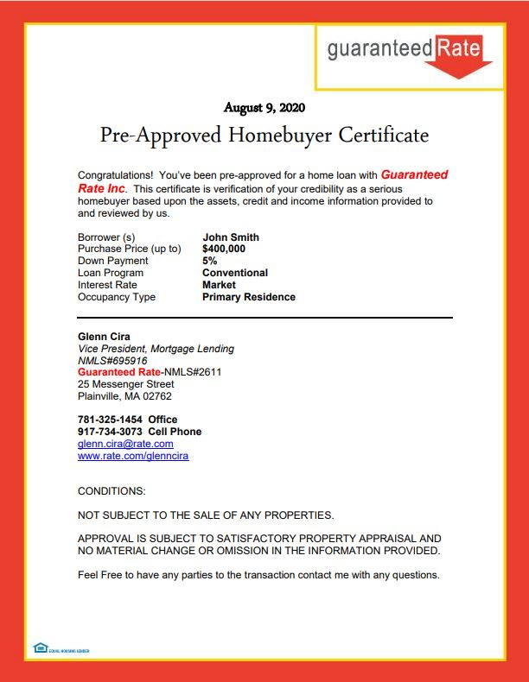
Pre-approval for Loan

Slide 11


Finding a Home
When we look at homes, we want to keep in mind your preference list, that can include, bedrooms, bathrooms, home style, square footage, must have amenities etc. This list might change as we go through the home process of finding your home and that is okay.
In the beginning, We will pull a list of homes that fits your initial criteria. You are encouraged to pull a list as well. We are also available to “preview” homes on your behalf to weed out the ones that might not fit your needs or flag homes you need to visit immediately. We will do the leg work and provide feedback, saving you time and travel.
We have a large network of other agents, vendors and potential sellers which us to spread the word regarding your needs and get the jump on any homes not yet listed in the MLS or on search sites.
On the days when we tour homes together, we’ll need to pre-plan the visits to allow the owners enough time to tidy up and leave the premises. When we are viewing, homes could start to blend together so we will make sure to go over the pros and cons of each house and adjust our criteria accordingly. Plan on looking at between 5 and 9 houses total - anything more indicates your priorities have changed and we’ll need to revisit your home search criteria. When we tour a property, you should focus on whether or not the house fits your needs and if you can see yourself living in the home.
We will not try to “sell” you the house. We are your advocate, not your salesman. Our job is to protect your interests by doing our best to ensure the home will not be a problem for you later on. We’ll be looking for potential problems, and assessing the overall condition of the property. When touring homes, point out any problems you see or details you dislike.
Once you find your dream home I’ll help you write a competitive offer. Otherwise, I’ll need to ask you what you liked and disliked about each house so we can adjust our candidates appropriately.

Slide 12

Making an Offer
When we find the home for you, we will place an competitive offer. It is important to know that an offer is a legally binding agreement. The steps in the offer are as follows:
We will come up with a price of the home you are comfortable buying the home for based on your approval from your bank/lender, and current market conditions and other similar homes that have sold in the area.
You will need a check for $1000. This is your earnest money to hold the property. It is to be known that this check is only deposited into escrow if your offer is accepted.
We will put a deadline on the offer for a response and a closing place and time to transfer the title into your name.
This is the time to also ask for anything you want specific in the home, ie. the refrigerator, washer, dryer or anything else. The home is only required to come with a stove and anything else that is affixed to the actual property.
The closing will happen between 45- 60 days after your accepted offer.
There is a chance that the seller might want to counter your initial offer and so plan for some negotiating to come to common ground. Always remember you want to buy a home and the seller wants to sell their home, its having patience to come to a win win situation for everyone and we will be with you every step of the way.
Possession - many times one party needs extra time to arrange a move or for a new home to be completed. We can negotiate a lease-back or other arrangement to meet both parties’ needs.
Contingencies - quite often a buyer must sell their existing home before purchasing a new one, or can only afford a certain monthly payment. We can help structure the offer so that you won’t be stuck with two mortgages,

Slide 13

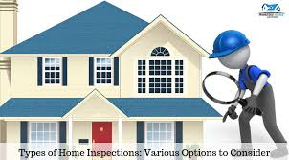
Your offer was Accepted
How to Choose a Good Inspection Company Is an Inspection Necessary?
- You have the right to request an inspection of any property you are thinking of purchasing, by a professional inspector of your choice. You should always exercise your right to have the inspected. Many of the critical and expensive systems such as mechanical, electrical, structural, and plumbing are not visible to the untrained eye. If repairs are needed, we can help you amend the contract to include them.
What Does an Inspection Entail?
An inspection consists of physically walking through the home (preferably with the buyer and their agent present), followed up by a written report detailing findings. They report on the general condition of the home’s electrical, heating, and air systems, interior plumbing, roof, visible insulation, walls, ceilings, floors, windows, doors, foundation, and visible structure.
The inspection is not designed to criticize every minor problem or defect in the home. No home is perfect. It is intended to report on major damage or serious problems that require repair for the well being of the home, or that might require significant expense
An Informed Buyer is Important:
- The primary purpose of the inspection is to help the buyer make an informed purchasing decision. The inspector should allow and even encourage the buyer to attend the home inspection. A good home inspector knows how the home’s many systems and components work together and how to minimize the damaging effects of sun and water. The buyer’s attendance of the inspection provides them with an overall idea of possible future repair costs and maintenance routines. This is valuable information which could decrease ownership costs and increase the future selling price of the home.

Slide 14
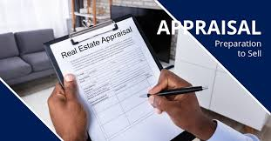

Between Contract & Closing
The Property Appraisal
  The lender will request an appraisal as part of the loan process to ensure that the market value of the property is high enough to cover the loan amount. The appraiser will take into account the recent selling price of other similar homes in the neighborhood, along with any homes for sale and the overall condition of the property.
Transferral of Services Into Your Name
Electric, Telephone, Cable Television, Internet, Trash, Water, Gas (if available). I will refer you to a FREE service that will connect all your services for you. We can also discuss the various internet service providers in the area and their quality

Slide 15

Between Contract & Closing
What Should I do to Prepare for the Closing?
You will be required to pay all fees and closing costs in the form of ‘guaranteed funds’ such as a Cashier’s Check. These days, many buyers wire the funds so it is wise to check with your preferred banking institution regarding wire fees and setup time before closing. You will be told the exact amount by your agent or escrow officer prior to closing.
You are also required to bring a picture ID such as your driver’s license. If your spouse or partner cannot attend the closing, you will need to obtain a Power of Attorney for them ahead of time. On the day of closing the escrow officer will contact your spouse to ensure the Power of Attorney is still valid. Be sure to have their contact information with you at closing for this purpose. It is possible to have the documents mailed out for signatures, but this will add time to the closing process and require advanced notice for the title company to prepare.
What Happens Next?
Once your lender releases the funds to the title company, you will receive the keys to your home and you can move in! Be aware that there may be a day or two delay between “closing” and “funding.” Make sure you schedule some flexibility into your moving plans to allow for a possible delay. We will work with your lender and the title company to minimize the possibility of this happening.
That’s it. We will check with you on a regular basis to ensure the move went smoothly and that the house is meeting your expectations. You are now our valued customer and we look forward to a long and rewarding relationship with you, whether this is your first house or your 15th.

